Slide 1
Linear mixed models in R Day 4
Jonas Walther

Slide 2
Error messages during model reduction
When reducing a maximal model (or running models in general) you can encounter the following error message:
## Warning in checkConv(attr(opt, "derivs"), opt$par, ctrl = control$checkConv, : ## Model failed to converge with max|grad| = 0.609847 (tol = 0.002, component 1)
## Warning in checkConv(attr(opt, "derivs"), opt$par, ctrl = control$checkConv, : Model is nearly unidentifiable: very large eigenvalue ## - Rescale variables?
This might indicate a problem with your data set, usually a variable that is not normally distribut.

Slide 3
Common transformations
Often independent variables are also transformed for use in LMEs
Common transformations for independent variables are:
Lograthmic
Reciprocal
Scaling
BUT much more important is the normal distribution of residuals (errors) and therefore the dependent variable (see Day 2)!

Slide 4
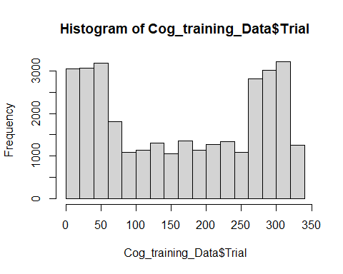
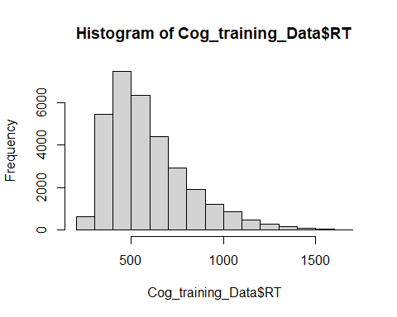
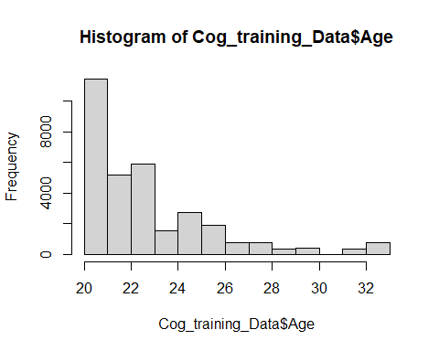
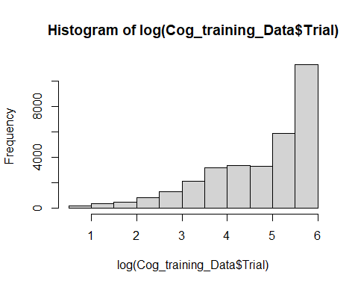
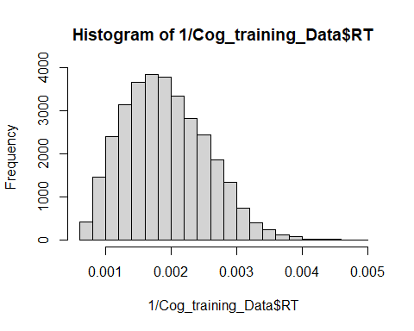
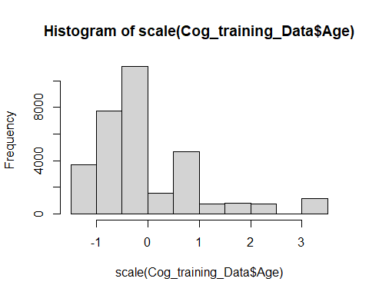
Common transformations

Slide 5
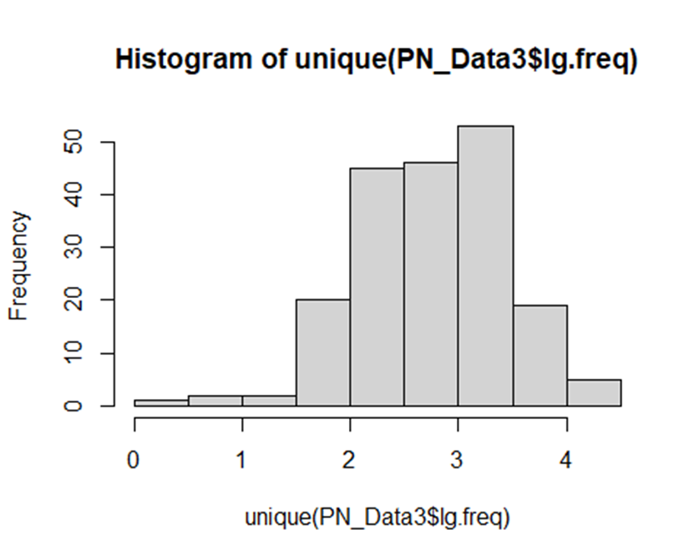
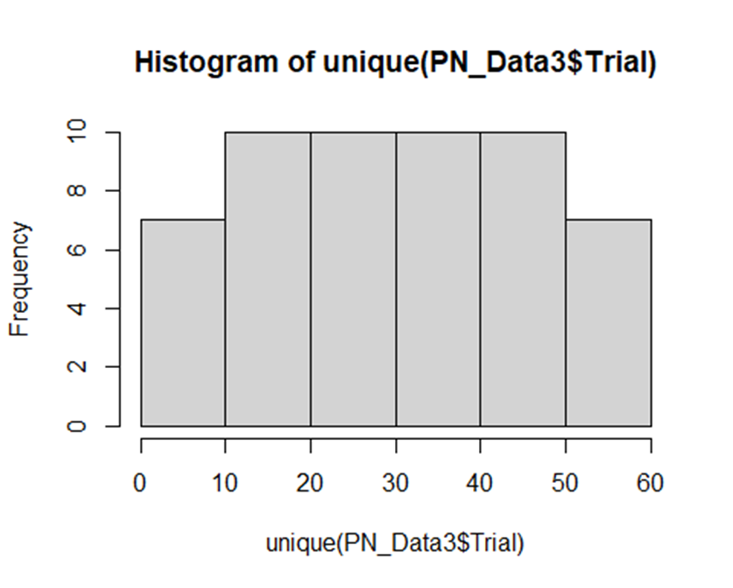
Shapiro-Wilk Test
Statistical test for checking if a variable is normally distributed
The sample size must be between 3 and 5,000
P-value below 0.05 indicates non-normally distributed data
shapiro.test(unique(PN_Data3$lg.freq))
## ## Shapiro-Wilk normality test ## data: unique(PN_Data3$lg.freq) ## W = 0.98921, p-value = 0.1534
shapiro.test(unique(PN_Data3$Trial))
## ## Shapiro-Wilk normality test ## data: unique(PN_Data3$Trial) ## W = 0.95542, p-value = 0.04305

Slide 6
Lo and Andrews (2015) To transform or not to transform: using generalized linear mixed models to analyse reaction time data
Transforming your data can obscure or create effects in your model results
GLMs might be a better tool to account for non-normal distributed data

Slide 7
Understanding model output
summary(model_Large3)
## Fixed effects: ## Estimate Std. Error t value ## (Intercept) 1020.739 23.344 43.726 ## GroupExperimental -76.150 29.565 -2.576 ## ContextUK -18.660 8.471 -2.203 ## GroupExperimental:ContextUK 53.089 11.706 4.535
 | PL Context | UK Context
Experimental Group
Control Group

Slide 8
Emmeans-package
library(emmeans)
em1 <- emmeans(model_Large3, specs = pairwise ~ Group:Context)
em1$emmeans
## Group Context emmean SE df asymp.LCL asymp.UCL ## Control PL 1021 23.3 Inf 975 1066 ## Experimental PL 945 23.5 Inf 899 991 ## Control UK 1002 23.3 Inf 956 1048 ## Experimental UK 979 23.4 Inf 933 1025 ## ## Degrees-of-freedom method: asymptotic ## Confidence level used: 0.95
Computes estimated marginal means (EMMs) for specified factors or factor combinations in a linear model and comparisons or contrasts among them
EMMs are also known as least-squares means

Slide 9
Emmeans-package
em1$contrasts
## contrast estimate SE df z.ratio p.value ## Control PL - Experimental PL 76.1 29.57 Inf 2.576 0.0491 ## Control PL - Control UK 18.7 8.47 Inf 2.203 0.1224 ## Control PL - Experimental UK 41.7 29.55 Inf 1.412 0.4919 ## Experimental PL - Control UK -57.5 29.51 Inf -1.948 0.2080 ## Experimental PL - Experimental UK -34.4 8.04 Inf -4.282 0.0001 ## Control UK - Experimental UK 23.1 29.51 Inf 0.782 0.8629 ## ## Degrees-of-freedom method: asymptotic ## P value adjustment: tukey method for comparing a family of 4 estimates

Slide 10
Understanding model output
Em1$emmeans
## Experimental PL 945 23.5 Inf 899 991 ## Experimental UK 979 23.4 Inf 933 1025
Em1$contrasts
## Experimental PL - Experimental UK -34.4 8.04 Inf -4.282 0.0001
945ms – 979ms = -34ms

Slide 11
Why the weird variable names?
summary(model_Large3)
## Fixed effects: ## Estimate Std. Error t value ## (Intercept) 1020.739 23.344 43.726 ## GroupExperimental -76.150 29.565 -2.576 ## ContextUK -18.660 8.471 -2.203 ## GroupExperimental:ContextUK 53.089 11.706 4.535
Lme4 uses contrast-coding or dummy-coding for categorical variables
Contrasts have two functions:
Control estimate calculation
Handling multilevel categories

Slide 12
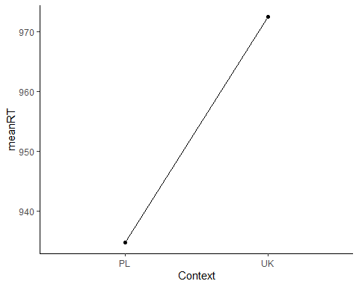
The explanatory variables are related linearly to the response.
Linear mixed effects models are linear and additive
Categorical variables are treated as 2-level variables

Slide 13
Contrasts
Categorical variables are used as factorial predictors, with several categorical levels
To estimate their effects, we assign numbers to each of the levels
These number are used for calculating comparisons
Different contrasts express different hypotheses
The underlying model remains the same, only the parametrisation of the effects changes
-> The choice of contrasts has no statistical consequence
-> It only changes estimate and hypothesis interpretation

Slide 14
Schad, D. J., Vasishth, S., Hohenstein, S., & Kliegl, R. (2020). How to capitalize on a priori contrasts in linear (mixed) models: A tutorial.
Implementing specific hypotheses into your model
Contrasts reparametrize the model and changes interpretation of parameters
R by default orders factors alphabetically and uses the first level as the baseline
Contrasts are the re-ordering of levels
Wide variety of contrast types
Treatment contrasts
Sum contrasts
Repeated contrasts
Polynomial contrasts

Slide 15
Treatment contrasts
Default setting of R
-> Categorical variables are sorted alphabetically and turned into treatment contrasts
-> Category levels are ‘dummy-coded’ with 0/1 values
-> The level coded as 0 is the ‘reference level’ or ‘baseline level’

Slide 16
Contrast implementation in R
contrasts(PN_Data$Context)
## UK ## PL 0 ## UK 1
PN_Data$Context <- factor(PN_Data$Context,levels = c("UK", "PL")) contrasts(PN_Data$Context)
## PL ## UK 0 ## PL 1

Slide 17
Treatment contrasts
## UK ## PL 0 ## UK 1
model_Large8 = lmer(RT ~ Group*Context + (1 | Subject) + (1| ItemNr), data=PN_Data) summary(model_Large8) ## Fixed effects: ## Estimate Std. Error t value ## (Intercept) 1020.81 23.42 43.589 ## GroupExperimental -76.20 29.45 -2.587 ## ContextUK -18.74 8.49 -2.208 ## GroupExperimental:ContextUK 53.00 11.73 4.517
## PL ## UK 0 ## PL 1
model_Large8 = lmer(RT ~ Group*Context + (1 | Subject) + (1| ItemNr), data=PN_Data) summary(model_Large8) ## Fixed effects: ## Estimate Std. Error t value ## (Intercept) 1002.07 23.36 42.895 ## GroupExperimental -23.19 29.40 -0.789 ## ContextPL 18.74 8.49 2.208 ## GroupExperimental:ContextPL -53.00 11.73 -4.517

Slide 18
Treatment contrasts
em1$contrasts
## contrast estimate SE df z.ratio p.value ## Control PL - Experimental PL 76.1 29.57 Inf 2.576 0.0491 ## Control UK - Experimental UK 23.1 29.51 Inf 0.782 0.8629
em1$emmeans
## Group Context emmean SE df asymp.LCL asymp.UCL ## Control PL 1021 23.3 Inf 975 1066 ## Control UK 1002 23.3 Inf 956 1048
## Fixed effects: ## Estimate Std. Error t value ## (Intercept) 1020.81 23.42 43.589 ## GroupExperimental -76.20 29.45 -2.587 ## ContextUK -18.74 8.49 -2.208 ## GroupExperimental:ContextUK 53.00 11.73 4.517
## Fixed effects: ## Estimate Std. Error t value ## (Intercept) 1002.07 23.36 42.895 ## GroupExperimental -23.19 29.40 -0.789 ## ContextPL 18.74 8.49 2.208 ## GroupExperimental:ContextPL -53.00 11.73 -4.517

Slide 19
Using different contrasts
Intercepts estimate the dependent variable when all predictors are at 0
If the ‘distance’ between the levels equals 1, then the slope estimates their difference
->estimates measure the difference per unit of the predictor

Slide 20
Sum contrasts
If all predictors have their mean at 0, then the intercept estimates the grand-mean (across levels)
-> You are centering your predictor on the mean
-> Sum contrasts use -0.5/05; -1/1; -2/2 etc for centering
-0.5/0.5 also maintains distance between levels at 1

Slide 21
Sum contrasts
contrasts(PN_Data$Context) <- contr.sum(2)/2 contrasts(PN_Data$Context)
## [,1] ## UK 0.5 ## PL -0.5
## Fixed effects: ## Estimate Std. Error t value ## (Intercept) 1011.44 23.00 43.973 ## GroupExperimental -49.70 28.84 -1.723 ## Context1 -18.74 8.49 -2.208 ## GroupExperimental:Context1 53.00 11.73 4.517
## UK ## PL 0 ## UK 1
## Fixed effects: ## Estimate Std. Error t value ## (Intercept) 1020.81 23.42 43.589 ## GroupExperimental -76.20 29.45 -2.587 ## ContextUK -18.74 8.49 -2.208 ## GroupExperimental:ContextUK 53.00 11.73 4.517

Slide 22
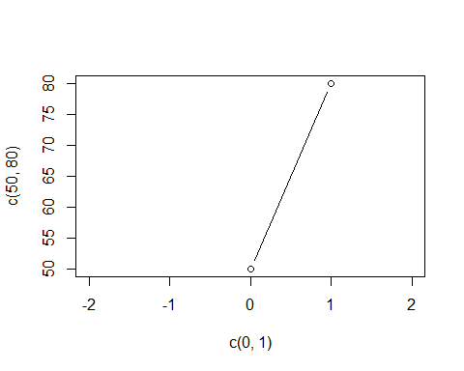
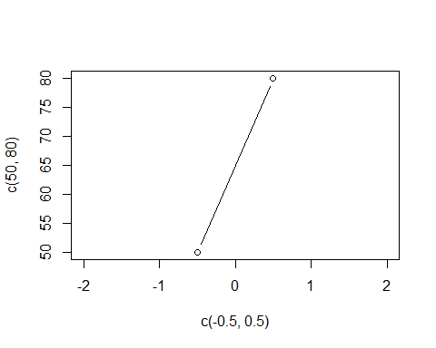
Treatment and sum contrasts

Slide 23
Contrasts for multilevel categories
Three level categories are more difficult
-> Contrasts include the creation of dummy variables for comparing all levels of a category with each other
## Fixed effects: ## Estimate Std. Error t value ## (Intercept) 1011.44 23.00 43.973 ## Context.1 -9.74 7.34 -1.784 ## Context.2 -2.54 8.75 -2.984 ## Context.3 -11.67 8.63 -2.648
-> R provides functions to automatically create different contrasts for multiple levels
-> part of the MASS package
library(MASS)

Slide 24
Multiple levels with Treatment contrasts
contrasts(PN_Data$Context) <- contr.treatment(5)
contr.treatment(5)
## 2 3 4 5 ## 1 0 0 0 0 ## 2 1 0 0 0 ## 3 0 1 0 0 ## 4 0 0 1 0 ## 5 0 0 0 1
Rows are group levels
Columns are tested comparisons
Control group against experimental groups
Default setting in R
First level is treated as control group
Evers other level is compared against it

Slide 25
Multiple levels with Sum contrasts
contr.sum(5)
## [,1] [,2] [,3] [,4] ## 1 1 0 0 0 ## 2 0 1 0 0 ## 3 0 0 1 0 ## 4 0 0 0 1 ## 5 -1 -1 -1 -1
Rows are group levels
Columns are tested comparisons
Experimental groups against grand average
Level with 1 is always compared against all others
Level 5 is set to -1, as it is already implicitly compared to all others

Slide 26
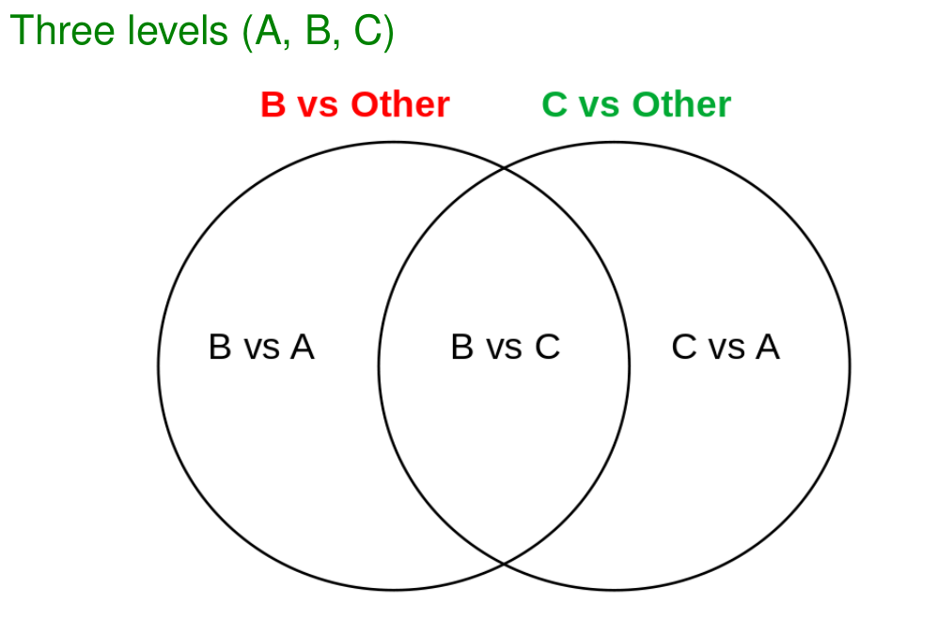
Multiple levels with Sum contrasts
contr.sum(5)
## [,1] [,2] [,3] [,4] ## 1 1 0 0 0 ## 2 0 1 0 0 ## 3 0 0 1 0 ## 4 0 0 0 1 ## 5 -1 -1 -1 -1
Rows are group levels
Columns are tested comparisons

Slide 27
Multiple levels with repeated contrasts
contr.sdif(5)
## 2-1 3-2 4-3 5-4 ## 1 -0.8 -0.6 -0.4 -0.2 ## 2 0.2 -0.6 -0.4 -0.2 ## 3 0.2 0.4 -0.4 -0.2 ## 4 0.2 0.4 0.6 -0.2 ## 5 0.2 0.4 0.6 0.8
Rows are group levels
Columns are tested comparisons
Comparisons are made between successive neighbouring levels
Requires ordered categories, but not evenly spaced ones
Centered around the grand average
Used for testing „increasing“ levels

Slide 28
Multiple levels with polynomial contrasts
contr.poly(5)
## .L .Q .C ^4 ## [1,] -6.324555e-01 0.5345225 -3.162278e-01 0.1195229 ## [2,] -3.162278e-01 -0.2672612 6.324555e-01 -0.4780914 ## [3,] -3.510833e-17 -0.5345225 1.755417e-16 0.7171372 ## [4,] 3.162278e-01 -0.2672612 -6.324555e-01 -0.4780914 ## [5,] 6.324555e-01 0.5345225 3.162278e-01 0.1195229
Rows are group levels
Columns are tested comparisons
Checking for linear, quadratic, cubical and quartic trends in categories
Required sorted and evenly spaced categories

Slide 29
Multiple levels with Helmert contrasts
contr.helmert(5)
## [,1] [,2] [,3] [,4] ## 1 -1 -1 -1 -1 ## 2 1 -1 -1 -1 ## 3 0 2 -1 -1 ## 4 0 0 3 -1 ## 5 0 0 0 4
Rows are group levels
Columns are tested comparisons
Comparisons of the level with all previous levels

Slide 30
LME to-do list

Slide 31
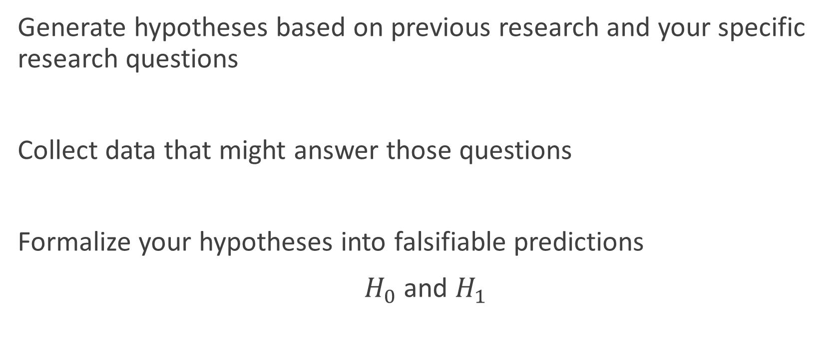
1 Hypotheses
Generate hypotheses based on previous research and your specific research questions
Collect data that might answer those questions
Formalize your hypotheses into falsifiable predictions
$H_{0}$ and $H_{1}$

Slide 32
2 Prepare your data
In order to use data in your models, you need to prepare it correctly:
Use the correct variable format (numeric, factor)
Apply transformations if necessary (log, scaling, reciprocal)
Apply contrasts for answering your research questions
load("PictureNaming.RData") Model_Data <- PN_Data %>% mutate(Context = as.factor(Context)) %>% select(Subject, Context, RT, Trial) %>% mutate(Trial = as.numeric(Trial)) %>% mutate(trans_RT = 1/RT) contrasts(Model_Data$Context) <- contr.sum(2)/2

Slide 33
3 Build your model
Create the maximal model based on your data structure (clustering variables) and all available sensible data
Reduce the model according to Barr et al (2013)
Check your model assumptions
Linearity
Constant variance for residuals
Normal distribution of residuals
If necessary go back to step 2

Slide 34
4 Analyse your model
Use summary() to get your model output
If desired with p-values using lmerTest
Understand and interpret your estimates of all fixed effects
Perform post-hoc test for (significant) interactions to understand the underlying driving effect

Slide 35
5 Report your results
Describe your data, your maximal and final model and your final statistical analyses
Create plots based on your model output

Slide 36
Questions and discussions
If you have anymore questions regarding previous lectures or your own research, please send me a mail to:
Jonas.walther@uni-tuebingen.de
We can discuss them during the course on Friday.

Slide 37
Evaluation
Please give your feedback for the course at:
https://evaluation.zeq.uni-tuebingen.de/evasys/public/online/

Slide 38

Thank you for your attention!

